Slide 1
CUSTOMER CHURN PREDICTION
BY: VAIBHAV SINGH
BATCH: MIP-ML-08

Slide 2
agenda
PROJECT OVERVIEW 3
EDA 9
DATA PREPROCESSING 19
MODEL DEVELOPMENT & EVALUATION 25
PREDICTING CHURN & RECOMMENDATIONS 35

Slide 3
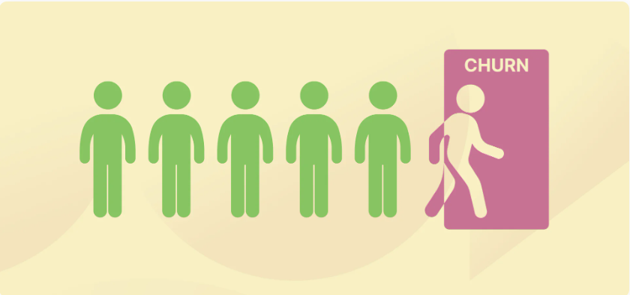
Customer churn refers to the loss of customers or subscribers for any reason at all. As a data analyst, the task at hand is to analyze the customer churn dataset to extract valuable insights. Through data exploration and statistical analysis, our aim is o uncover patterns, trends and correlations within the dataset. By presenting these findings, the agenda is to contribute in reducing the customer churn.
PROJECT OVERVIEW

Slide 4
Dataset Overview
customerID : CustomerID
Gender : Customer’s gender
SeniorCitizen: Whether the customer is a senior citizen or not
Partner : Whether the customer has a partner
Dependents : Whether the customer has dependents
Tenure : No. of months the customer has stayed with the company
PhoneService : Whether the customer has multiple phone lines
MultipleLines : Whether the customer has multiple phone lines
InternetService : Type of internet service
OnlineSecurity : Whether the customer has online security
OnlineBackup : Whether the customer has online backup

Slide 5
Dataset Overview
DeviceProtection : Whether the customer has device protection
TechSupport : Whether the customer has tech support
StreamingTV : Whether the customer has tech support
StreamingMovies : Whether the customer streams movies
Contract : Type of contract
PaperlessBilling : Whether the customer uses paperless billing
PaymentMethod : Mode of payment
MonthlyCharges : Charges per month
TotalCharges : Total charges
Churn : Target variable, indicating whether the customer churned

Slide 6
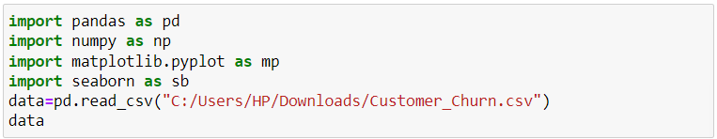
Importing essential libraries
Essential libraries are imported.
Dataset is read from the stored location.

Slide 7
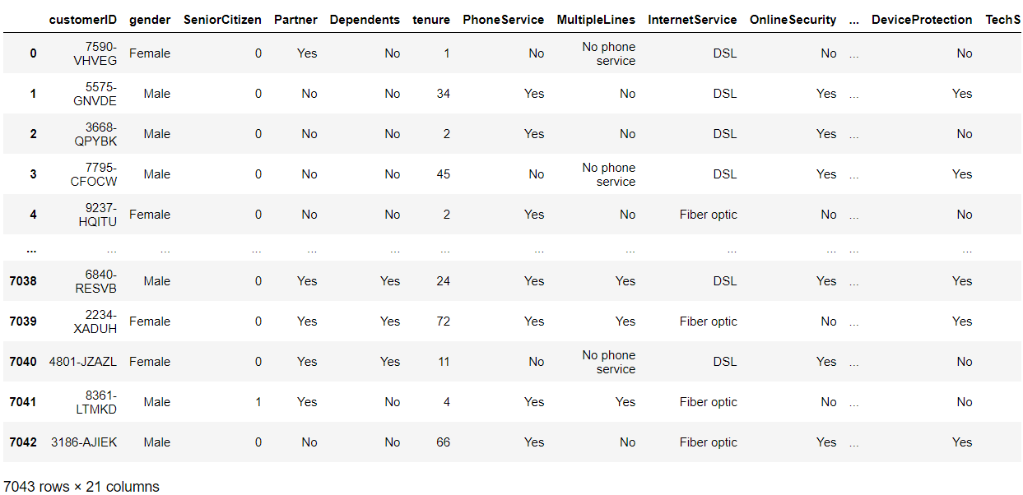
Provided dataset
We can observe that there are 7043 rows and 21 attributes in the provided dataset.
Attributes:
customerID
Gender
SeniorCitizen
And many more

Slide 8
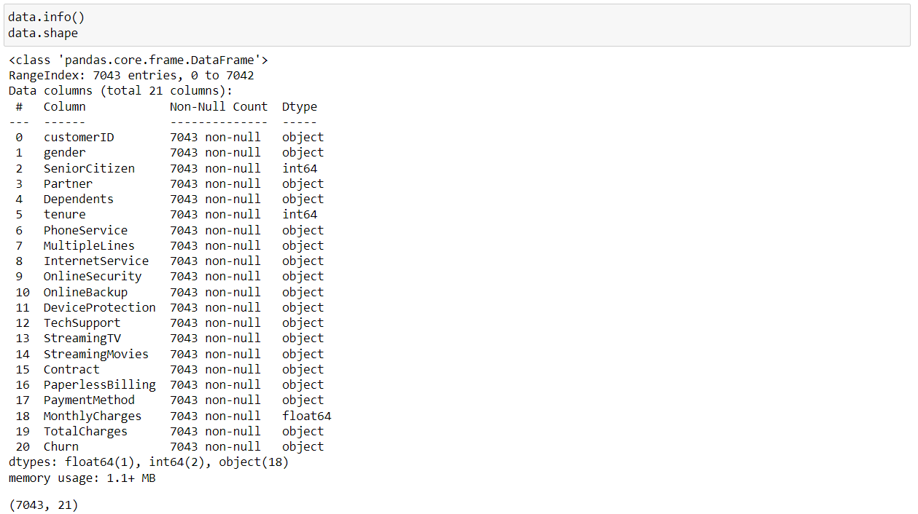
Dataset Information
We can see each attributes with number of data within self, and their data type like object, int and float as well. Null count of each attribute is also given.
In this case there was 11 null values in TotalCharges and was removed in Data Preprocessing, which we’ll observe in later stage of our slide.

Slide 9
EDA
In EDA, we’ll observe the hidden patterns and statistical measures using data visualization.

Slide 10
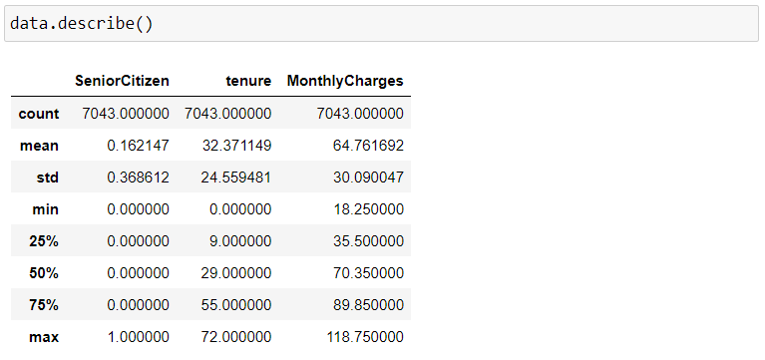
Dataset Description
We can observe the statistical measures like mean, standard deviation, maximum and minimum values along with various quartile ranges of our dataset.

Slide 11
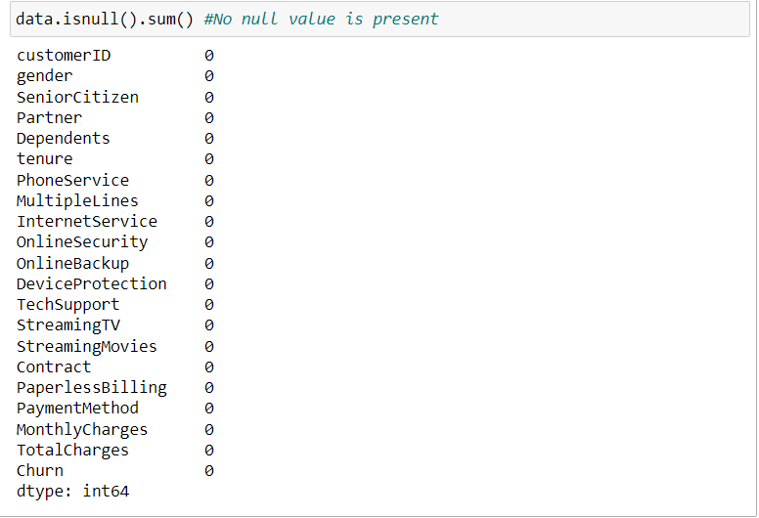
Null count of attributes
Here we can see the null count of each attribute is zero, as in TotalCharges there was 11 null values, which has been removed.

Slide 12
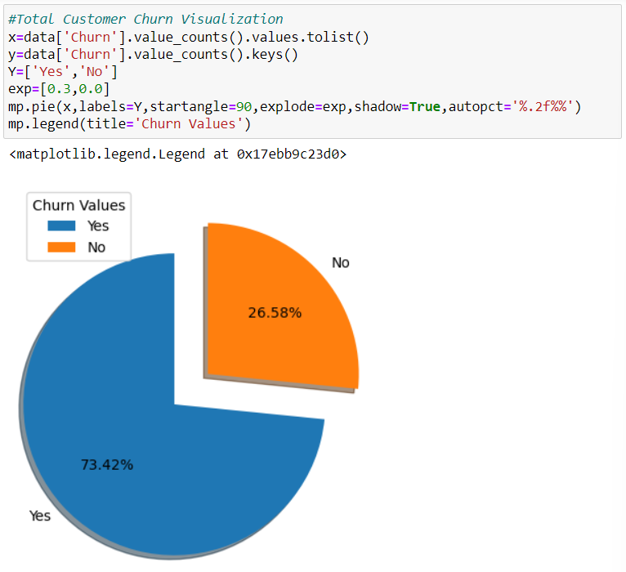
Data Visualization
Total Customer Churn visualization using pie chart.
We can observe that 73.42% of customer churns out and only 26.58% of the customer remains loyal and stays with the company/brand.
Further, we’ll see insights on the basis of few attributes.

Slide 13
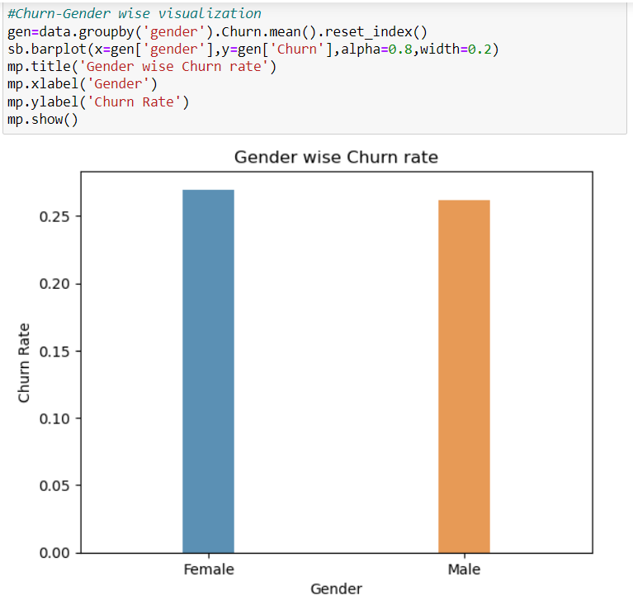
Churn-Gender wise Visualization
Churn-Gender wise visualization using bar chart.
We can observe that females churn out more as compared to males.

Slide 14
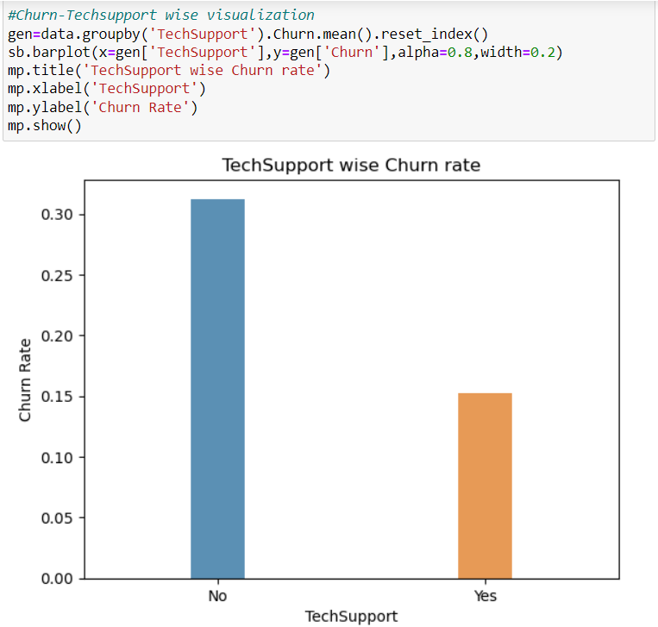
Churn-TechSupport wise Visualization
Churn-TechSupport wise visualization using bar chart.
We can observe that the customers who don’t receive technical support churns out more.

Slide 15
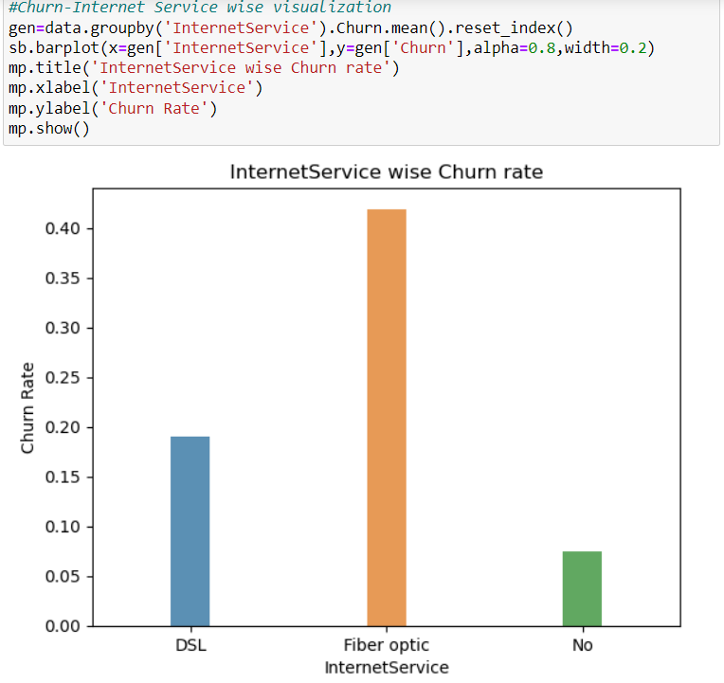
Churn-InternetService wise Visualization
Churn-InternetService wise visualization using bar chart.
We can observe that the customers who have DSL are more likely to churn out as compared to the ones who don’t’ have neither DSL or Fibre Optic connection
Whereas customers with Fibre optic has most likely to churn out.

Slide 16
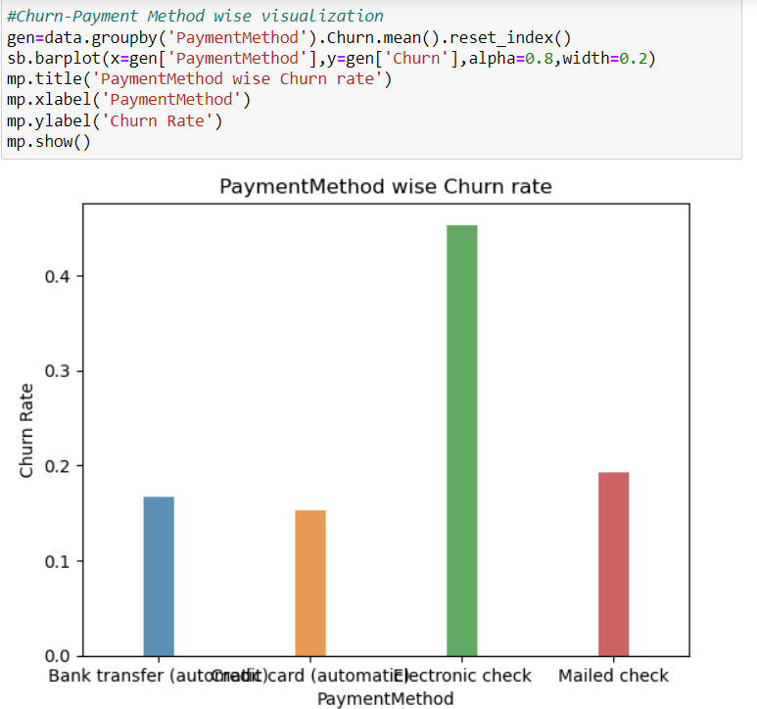
Churn-PaymentMethod wise Visualization
Churn-PaymentMethod wise visualization using bar chart.
We can observe that the customers with electronic check are most likely to churn out.

Slide 17
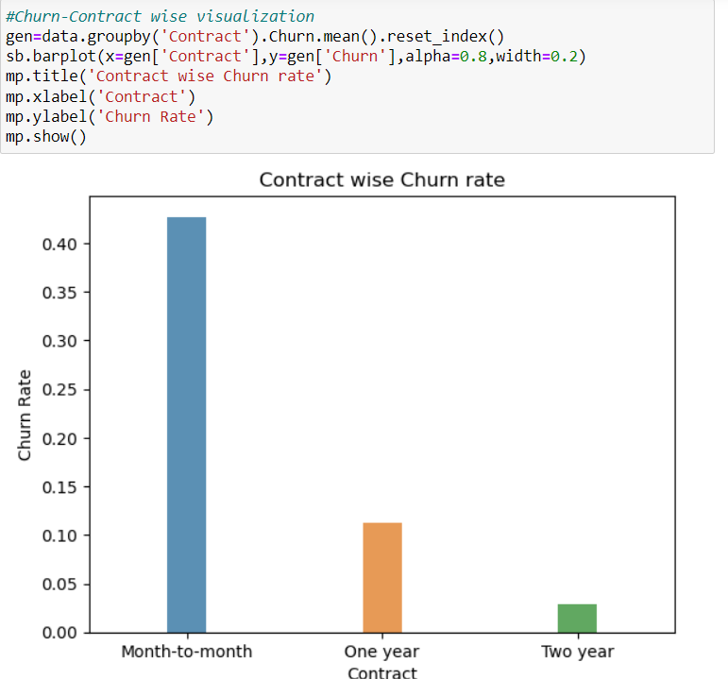
Churn-Contract wise Visualization
Churn-Contract wise visualization using bar chart.
We can observe that the customers with month-to-month subscription are most likely to churn out.
More the subscription period less likely it is to churn out.

Slide 18
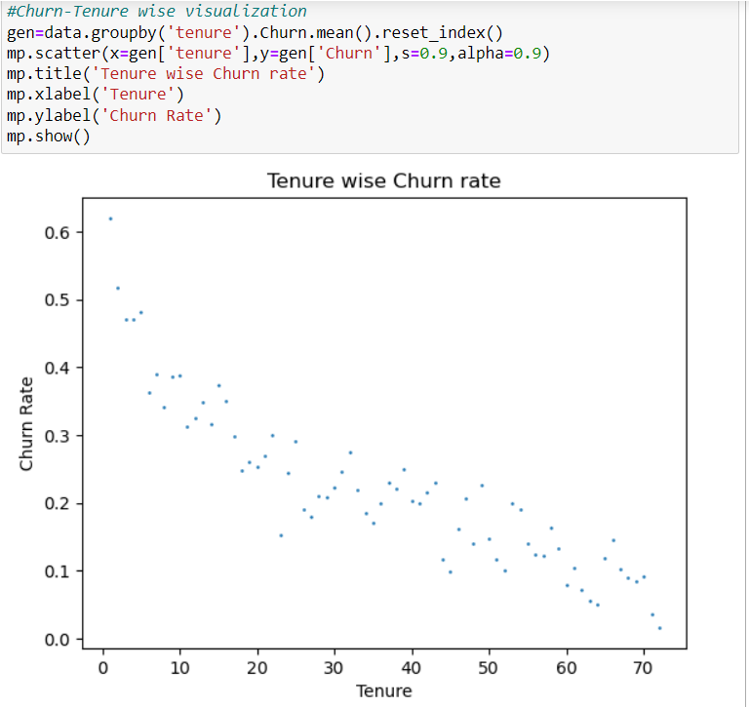
Churn-Tenure wise Visualization
Churn-Tenure wise visualization using bar chart.
We can observe that the customers with higher tenure with the company is less likely to churn out.

Slide 19
Data Preprocessing
Data preprocessing is performed on the given dataset in various ways like:
Removing null values
One-hot encoding
Feature scaling or normalizing

Slide 20
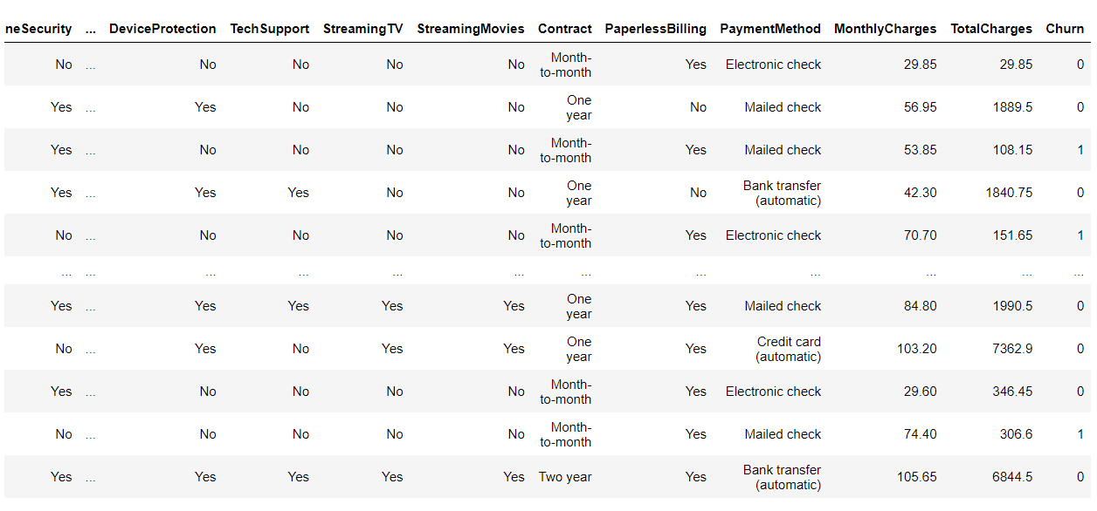
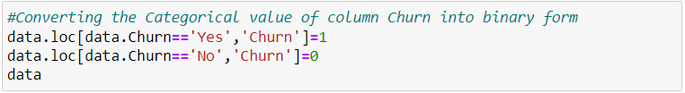
Converting Categorical value into binary form

Slide 21
Reducing Null values

Slide 22
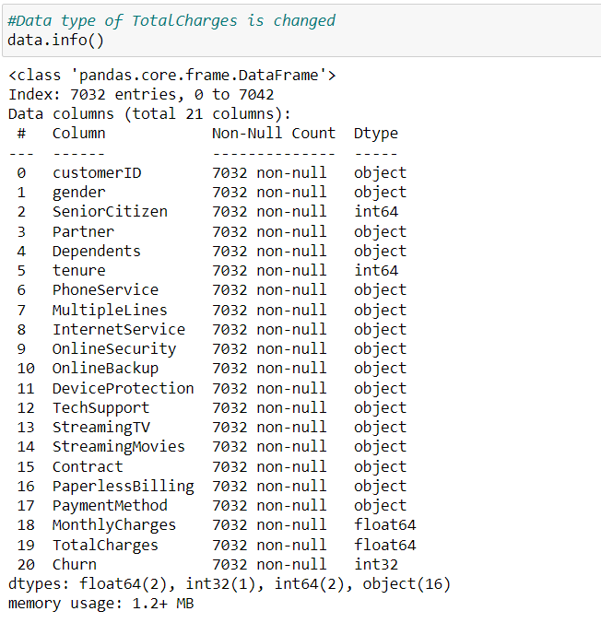
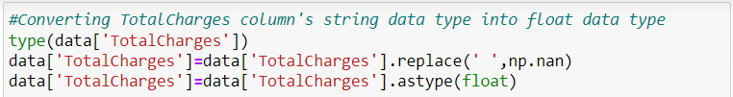
Converting Data Type

Slide 23
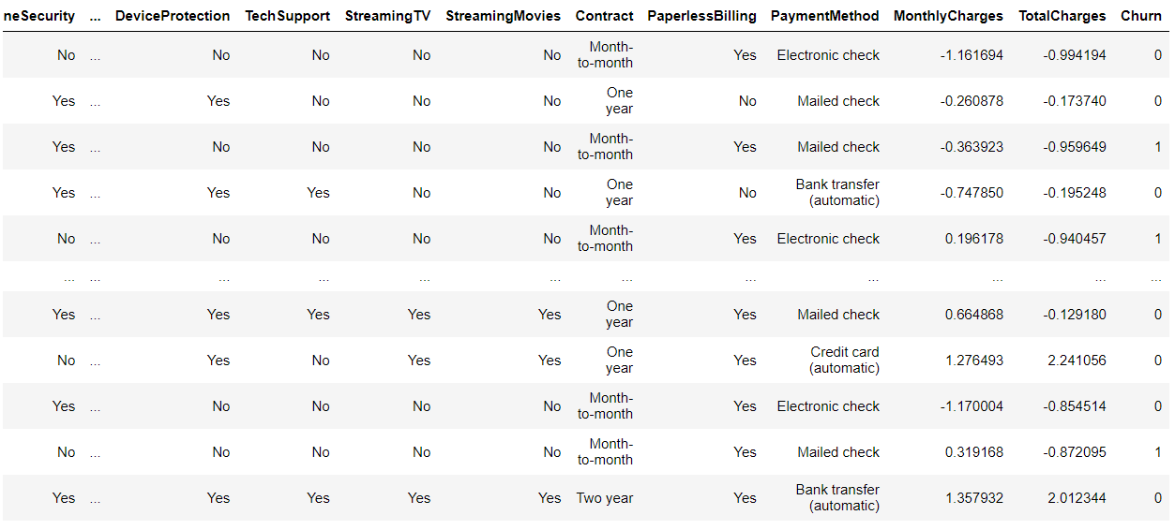
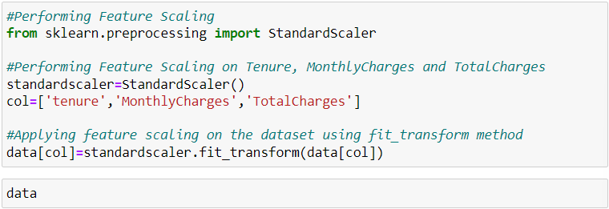
Feature Scaling

Slide 24
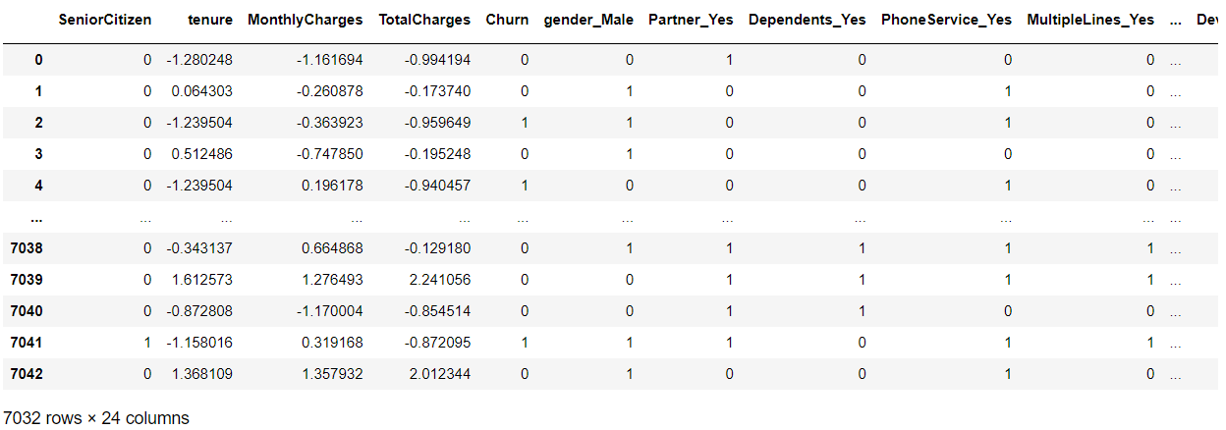
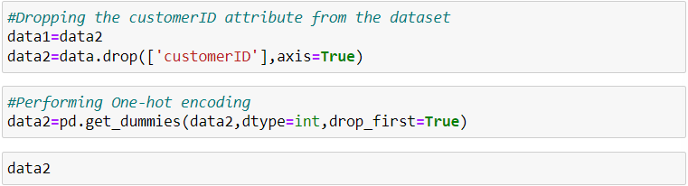
One-hot Encoding

Slide 25
Machine Learning Model Development & Evaluation
Train various machine learning models for classification

Slide 26
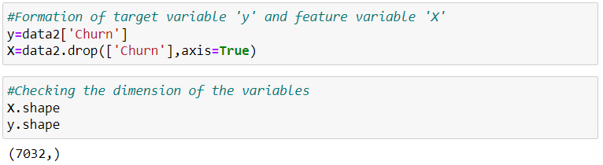
Creation of variables

Slide 27
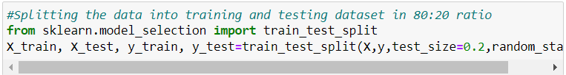
Data Splitting
Data is split into training and testing data in 80:20 ratio respectively.

Slide 28
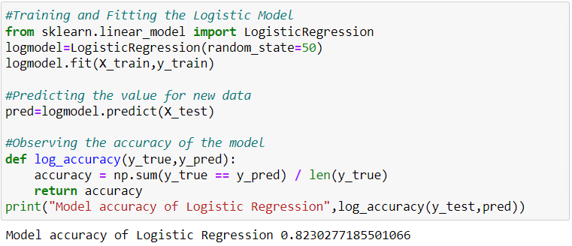
Logistic Regression Model
Using Logistic Regression, we get the accuracy of 82.30%.

Slide 29
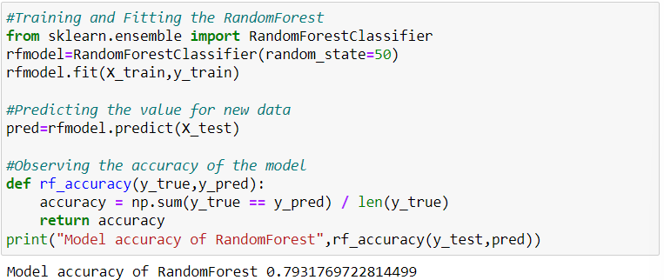
Random Forest Model
Using Random forest, we get the accuracy of 79.31%.

Slide 30
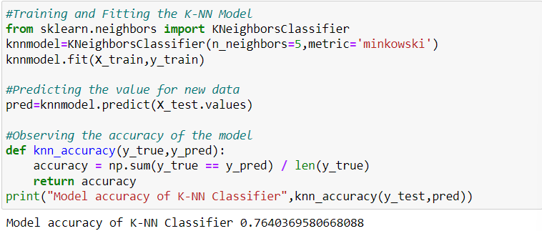
K-NN Classifier Model
Using K-NN Classifier, we get the accuracy of 76.40%.

Slide 31
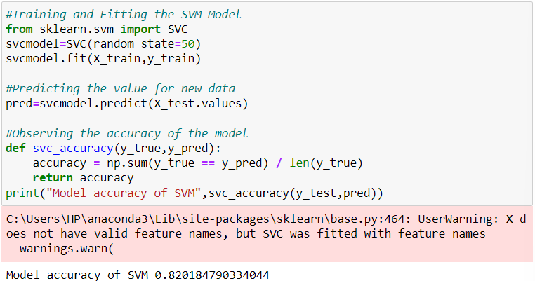
SVM Model
Using SVM, we get the accuracy of 82.02%.

Slide 32
Model Evaluation
Assessing the performance of our models and comparing each

Slide 33
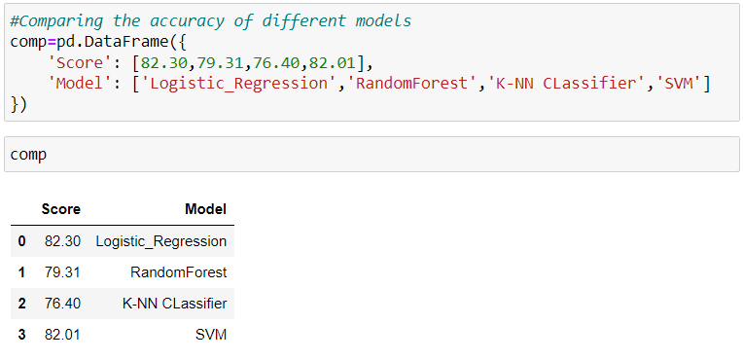
Model Evaluation & Comparison
We can observe that the accuracy score Logistic Regression is highest amongst all.

Slide 34
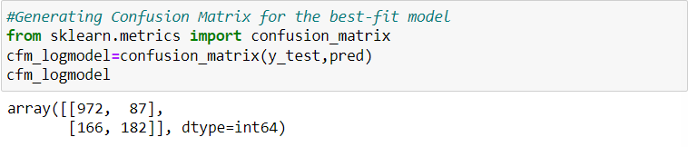
Confusion Matrix of Logistic Regression

Slide 35
Predicting the Churn Probability
Let us see the churn probability of each customer

Slide 36
Predicting Churn

Slide 37
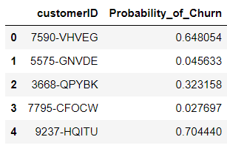
Dataframe of Customer Churn Probability

Slide 38
Recommendation
Give your loyal customers reasons to stick around with your brand. Loyal customers not only buy regularly from you but also suggest their family, friends, and business associates to you. Offer loyalty or reward points, birthday/anniversary discounts reward points that can be redeemed, etc.
Customer is the king and rightly said. For a business, it is extremely important to know if its customers are satisfied with its products or services. The easiest way to know that takes a quick customer satisfaction feedback. Ask your customers the right questions to get the right feedback, which will ultimately help you make informed decisions/ timely changes (if needed) thereby reducing the number of dissatisfied customers.
Offer them long-term discounts. A long-term discount or contract should benefit both, the business and the customer.

Slide 39
thank you
VAIBHAV SINGH
vaibhav.vaibhavsingh.singh80@gmail.com
MIP-ML-08
MENTORNESS

